Slide 1
Child Sexual Exploitation (CSE)
Guidance for HSWF Volunteers

Slide 2
What is CSE ?
CSE is a form of sexual abuse
Definition: CSE involves
“Exploitative situations, contexts and relationships where young people under 18 years receive something (e.g. food, accommodation,drugs, alcohol,affection, gifts, money) as a result of them performing and/or others performing on them sexual activities.”
(Department for Education 2009)

Slide 3
In all cases of CSE
Those exploiting the child will have power over them by virtue of
Age
Gender
Intellect
Physical strength
Economic power

Slide 4
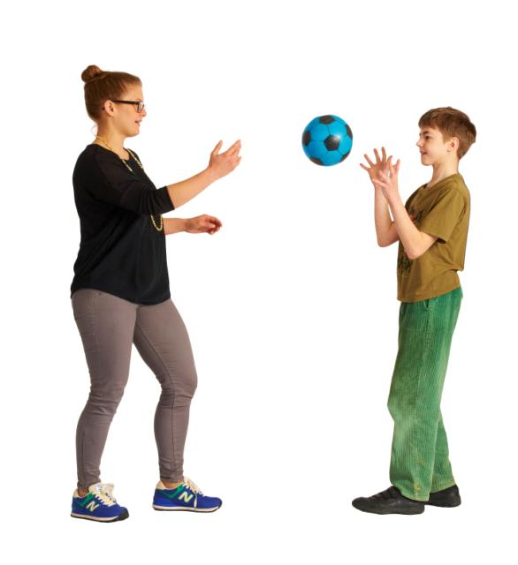
Who might be vulnerable to CSE ?
Take 10 minutes to work in pairs to list the added vulnerability factors we think may lead to a child being a victim of CSE.

Slide 5
Underlying Vulnerability factors in family
Child sexual abuse
Domestic abuse
Family Breakdown
Physical abuse and emotional deprivation
Bullying in or out of school
Homophobia towards a young person from family
Adult family member involved in prostitution

Slide 6
Alcohol or other substance use in family
Parental mental health issues
Parental learning disabilities
Child being estranged from family
Death or illness of significant family member
Isolated by virtue of being an asylum seeker or migrant family with frequent moves
Child Looked After by Local Authority

Slide 7
The push-pull effect
These issues can service to push a child away from their family and pull them towards risky or exploitative relationships with others
HOWEVER: children from loving and supportive families can also be at risk of CSE.

Slide 8
Grooming at a glance Grooming is when someone builds an emotional connection with a child to gain their trust for the purposes of sexual abuse or exploitation. Children and young people can be groomed online or in the real world, by a stranger or by someone they know - for example a family member, friend or professional. Groomers may be male or female. They could be any age. Many children and young people don't understand that they have been groomed, or that what has happened is abuse.

Slide 9
Risk Indicators Behaviours
What might we see/notice that might indicate a child or young person is at risk/a victim ?

Slide 10
Low level indicators
Regularly going missing or coming home late with no explanation
Overly sexualised dress or sexualised risk taking (including internet)
Unaccounted for monies or goods
Associating with unknown adults
Associating with other sexually exploited children
Reduced contact with family and friends
Notable changes in behaviour/loss or previous interests
Experimenting with drugs/alcohol
Poor self image/eating disorders/self harm

Slide 11
Repeat screening for sexually acquired infection, emergency contraception or unplanned pregnancies
Having much older boyfriend/girlfriend
Missing school/excluded from school
Persistent truancy or going missing from home or school
Offending behaviour
Immediate response to texts/phonecalls and increasing secretiveness
Spending long time in chat rooms or accessing inappropriate material online

Slide 12
Medium level risk factors
Association with gangs or gang related activity
Sexual identity issues
Propensity to sexual experimentation with older adults
Repeat offending
Decrease in self care
Returning from missing episodes with bruising or other injuries
Suggestions they have been locked in or limitations on freedom
Developing drug or alcohol dependency
Turning up at A&E/out of hours with unknown adult.

Slide 13
High risk level indicators
Getting into cars with unknown adults
Associating with perpetrators
Clipping (offering to have sex for money then running before having sex)
Receiving rewards for recruiting peers into exploitation
Disclosure of assault then withdrawal of complaint
Being seen in hotspots (e.g., hotel thought to link with CSE) or with known perpetrators
Child under 13 years of age engaging in penetrative sex with over 15 year old
Being taken to clubs and hotels by adults for purpose of sexual activity

Slide 14
Being bought or sold by adults
Multiple miscarriages or terminations
Pattern of street homelessness and staying with an adult suspected of CSE
Child under 16 meeting different adults and engaging in sexual activity
Removed from red light district due to suspected CSE
Allegation of abduction/forced imprisonment
Disappearing from the system with no contact or support
Being moved around for sexual activity (trafficking)

Slide 15
What makes a child more resilient/protected ?
Parents/carers recognise their child is being groomed and this is impacting on their behaviours
Parents/carers accept support and mediation in relationship with young person
Parents/carers work with police to facilitate prosecution of perpetrators
Young person builds close relationship with one safe friend or professional
Professionals are available to provide support and work as a team with family and young person

Slide 16
Worcestershire CSE Pathway
This flowchart shows process followed if CSE victims are identified.

Slide 17
What can HSWF do ?
Volunteers already support adult survivors of CSE
The Rotherham and Oxford Enquiries highlighted the role the VCS plays in identifying abuse and offering support to victims and the wider family
Volunteers can be aware – a family may talk to you about these issues or could be concerned about a young persons` behaviour.

