Slide 1
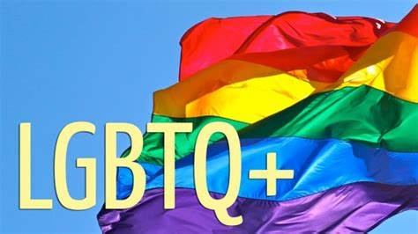
2023
Registered Charity No 1120436

Slide 2
This session will
Define LGBTQ+
Look at terminology used for the LGBTQ + community
Consider risks, discrimination and experiences of LGBTQ+ people
Remind ourselves how to support a parent or young person who is LGBTQ+ at HSWF
Look at other support available

Slide 3
What is LGBTQ+ ?
Lesbian
Gay
Bisexual
Trans
Q ueer/Questionning
+ Plus (pansexual, non binary, asexual, intersex)

Slide 4
Orientation and identity
Sexual orientation
An inherent or immutable enduring emotional, romantic or sexual attraction to other people. Note: an individual’s sexual orientation is independent of their gender identity.
Gender identity
One's innermost concept of self as male, female, a blend of both or neither – how individuals perceive themselves and what they call themselves. One's gender identity can be the same or different from their sex assigned at birth.

Slide 5
Lesbian and Gay
LESBIAN
A woman whose enduring physical, romantic, and/or emotional
attraction is to other women.
Some lesbians may prefer to identify as gay or as gay women.
GAY
The adjective describes people whose enduring physical,
romantic, and/or emotional attractions are to people of the same sex.
Sometimes lesbian is the preferred term for women.
A woman who is emotionally, romantically or sexually attracted to other women. Women and non-binary

Slide 6
Bisexual (Bi)
A person who can form enduring physical, romantic, and/or emotional attractions to those of the same gender or more than one gender. People may experience this attraction in differing ways and degrees over their lifetime. Bisexual people need not have had specific sexual experiences to be bisexual; they need not have had any sexual experience at all to identify as bisexual.

Slide 7
Transgender (Trans)
An umbrella term for people whose gender identity and/or gender expression differs from what is typically associated with the sex they were assigned at birth.
Some transgender people are prescribed hormones by their doctors to bring their bodies into alignment with their gender identity. Some undergo surgery as well. But not all transgender people can or will take those steps, and a transgender identity is not dependent upon physical appearance or medical procedures.

Slide 8
Queer/Questioning
QUEER
An adjective used by some people whose sexual orientation is not exclusively heterosexual or straight. This umbrella term includes people who have nonbinary, gender-fluid, or gender nonconforming identities. Once considered a pejorative term, queer has been reclaimed by some LGBTQ+ people to describe themselves; however, it is not a universally accepted term even within the LGBTQ+ community.
QUESTIONING
Sometimes, when the Q is seen at the end of LGBT, it can also mean questioning. This term describes someone who is questioning their sexual orientation or gender identity.

Slide 9
+ Plus
The ‘plus’ is used to signify all of the gender identities and sexual orientations including :
Asexual: a person who does not experience sexual attraction. Sometimes shortened to “ace,” it is an umbrella term that can also include people who are demisexual (do experience some sexual attraction), graysexual (may not fit the strictest definition of the word asexual); and aromantic (they experience no romantic attraction and/or has little to no desire to form romantic relationships).
Pansexual :is sexual, romantic, or emotional attraction towards people regardless of their sex or gender identity. Pansexual people may refer to themselves as gender-blind.
Intersex: a person with one or more innate sex characteristics, including genitals, internal reproductive organs, and chromosomes. Do not confuse having an intersex trait with being transgender. Intersex people are assigned a sex at birth — either male or female — by medical providers/parents. May not match the gender identity of the child. Not all intersex folks identify as being part of the LGBTQ+ community.

Slide 10
What sort of discrimination might a member of the LGBTQ+ community experience ?

Slide 11
History snapshot of LGBTQ+ Community
1965 – House of Lords proposal to decriminalise male homosexual acts (lesbian acts had never been illegal). A UK opinion poll finds that 93% of respondents see homosexuality as a form of illness requiring medical treatment.
1967 – Decriminalisation of homosexual acts between two men over 21 years of age in private in England.
1972 – The First British Gay Pride Rally was held in London with an estimated 200-700 people marching.
1981: First case of AIDS recorded.
1988 – Section 28 of the Local Government Act 1988 stated that a local authority "shall not intentionally promote homosexuality or promote the teaching in any maintained school of the acceptability of homosexuality, as a pretended family relationship". The act was introduced by Margaret Thatcher.

Slide 12
1989 – The campaign group Stonewall UK is set up to oppose Section 28 and other barriers to equality.
1994 The Conservative Member of Parliament Edwina Currie introduced an amendment to lower the age of consent for homosexual acts, from 21 to 16 in line with that for heterosexual acts. The vote was defeated and the gay male age of consent was instead lowered to 18.
2001 The provisions of the Sexual Offences Amendment Act came into force throughout the United Kingdom, lowering the age of consent to 16.
2002 Same-sex couples are granted equal rights to adopt.
2003 Employment Equality Regulations made it illegal to discriminate against lesbians, gays or bisexuals at work.

Slide 13
2005 The first civil partnership took place. The Gender Recognition Act allows people to change their legal gender.
2007 Discrimination against lesbians and gay men in the provision of goods and services becomes illegal. Some 8,728 civil partnerships were conducted.
2010 The Equality Act 2010 makes discrimination on grounds of gender reassignment in employment and in the provision of goods and services illegal.
2014 Same-sex marriage becomes legal in England and Wales.
2016 The Armed Forces Act 2016 finally repeals "homosexual acts as a grounds of discharge from the armed forces.
2019 5 million people attend Pride events internationally.
2021 The UK census includes questions on gender identity and sexual orientation for the first time, meaning that data can be gathered on the numbers of LGBT people across the country.

Slide 14
LGBTQ+ people have higher risks of
Suicide and suicidal thoughts (twice as likely to contemplate suicide)
Self harm (three times more likely to self-harm)
Mood disorders and anxiety (one and a half times more likely than peers)
Eating disorders (44% of LGBTQ+, compared to 6% peers)
Alcohol and substance abuse (16% use daily, compared to 10% peers)
Hate crimes/assault (nine times more likely than peers)

Slide 15
Where is support available ?
HSWF – our inclusive, accessible service is available to any main carers of children 0-18years
www.stonewall.org.uk Information and advice
galop.org.uk Helplines and other support for LGBT+ adults and young people who have experienced hate crime, sexual violence or domestic abuse.
www.mermaidsuk.org.uk Supports gender-diverse young people aged 19 and under, and their families and carers.
www.tht.org.uk Provides support for LGBT+ people worried about their sexual health, including via a listening service.
www.theproudtrust.org resources for parents of LGBTQ+ young people

Slide 16
Why are LGBTQ+people at greater risk?
Institutional prejudice manifesting as laws and policies which create inequalities and/or fail to provide protection from discrimination
Experience of discrimination in the form of physical or verbal harassment, physical or sexual assault
Lack of support from parents, friends and other family members
Stress related to fear of coming out or transitioning, including the potential backlash and life disruption, as well as considering the risks and sometimes lengthy time period involved
Gender dysphoria, or distress related to a conflict between one’s physical or assigned gender and the gender with which they identify (Bailey et al., 2014; Haas et al., 2011; Suicide Prevention Resource Centre [SPRC], 2008; Taylor et al., 2011).

Slide 17
How can we support someone from the LGBTQ+ community ?

Slide 18
How can we support LGBTQ+ adults and young people ?
Listen and be open-minded, be willing to talk.
Don't assume that all your friends and co-workers are straight. Someone close to you could be looking for support in their coming-out process. Not making assumptions will give them the space they need.
Anti-LGBTQ+ comments and jokes are harmful. Let your friends, family and co-workers know that you find them offensive.
Confront your own prejudices and bias, even if it is uncomfortable to do so.
Defend your LGBTQ+ friends against discrimination.
Believe that all people, regardless of gender identity and sexual orientation, should be treated with dignity and respect.
If you see LGBTQ+ people being misrepresented in the media, contact glaad.org.

Slide 19
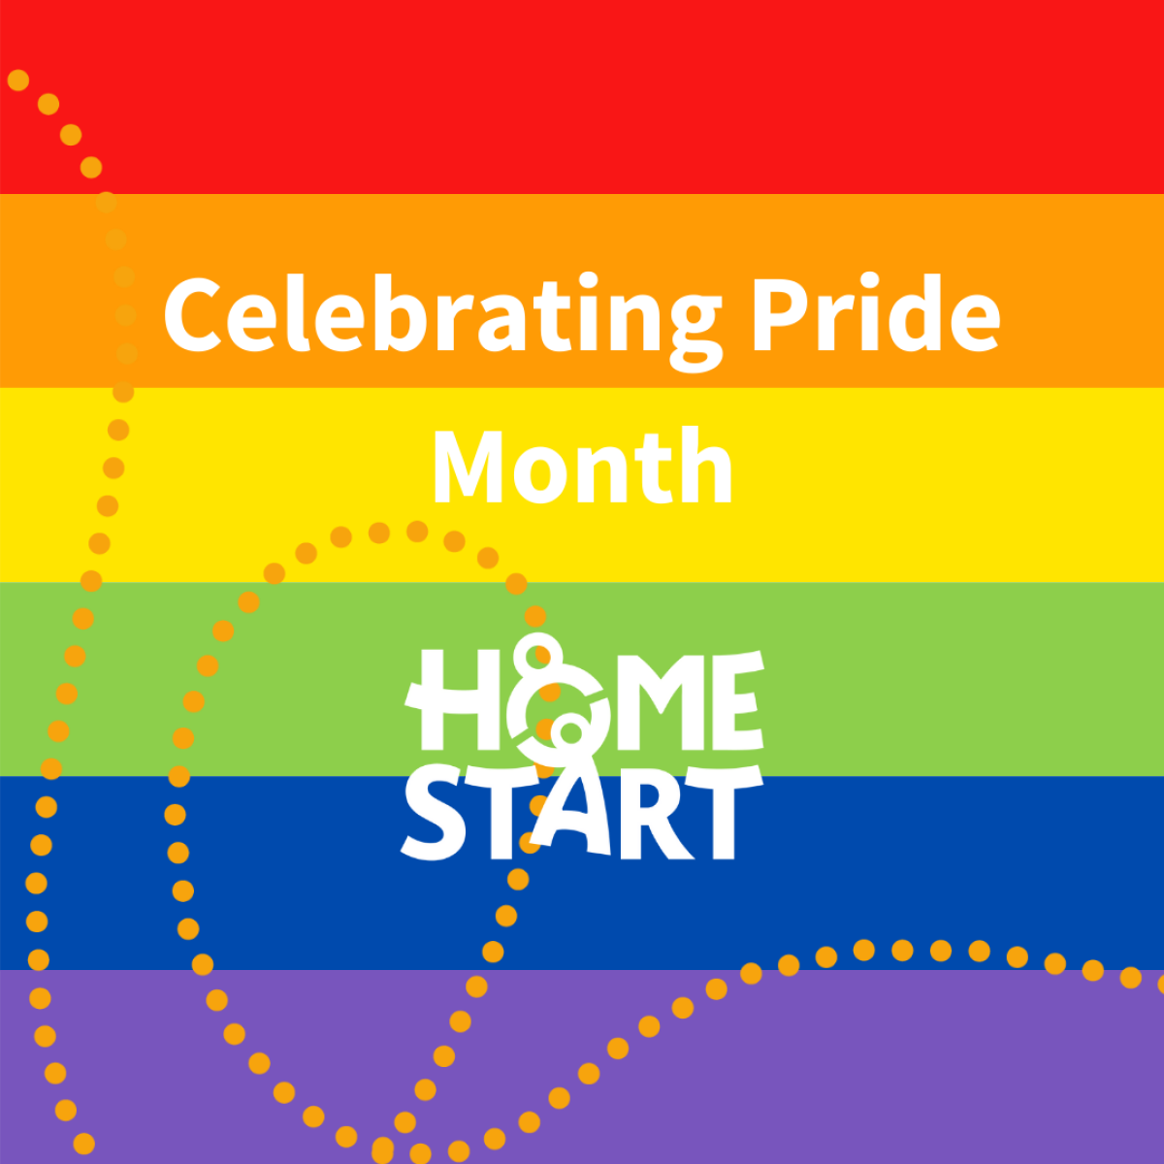
How would you feel as a HSWF
Volunteer in these situations ?

Slide 20
Resources and further information

