Slide 1
Home-Start Wyre Forest Registered Charity No. 1120436 A company Limited by Guarantee No 5419029

Slide 2
Who are we?
Home-Start Wyre Forest is one of around 300 Home-Start schemes nationwide. We were set up in Kidderminster in 1995.
The Scheme is made up of 6 paid staff and 108 volunteers who govern scheme and deliver service.
Home-Start Wyre Forest is 1 of 3 schemes in Worcestershire.
Last year we supported 471 children in 234 families.
Notes:
The Home-Start network consists of Home-Start UK and 337 affiliated schemes. Together they form the Home-Start service, delivering one-to-one support, friendship and practical help to young families. In 1973, Margaret Harrison, a voluntary worker with families in Leicester, recognised that although a lot of work was being done directly with children, the parents also needed support through difficult times, this was affecting their children.

Slide 3
Our Families
Must be main carer of a child (birth- eve of 18th Birthday) or be pregnant
Must be in need of emotional and/or practical support
Must live in the Wyre
Forest.

Slide 4
What do we do for families?
We offer a free, confidential, non judgmental
befriending service.
Core Service
Volunteer weekly home-visiting to the family home to offer parent to parent support.
Additional Services
After school Family Group (families with over 5`s)
CAPS – Child Abuse Psychology Service
Trips/Signposting/donation swap shop.
Notes:
Practical support: Watching children while parent has rest, housework etc/Accompanying to doctors apts/ help with shopping/going out
Emotional support: Confidential, non judgemental listening ear

Slide 5
Befriending is…
“…the dedicated support of another person to help them navigate their way through difficulties. It covers a range of supportive and purposeful activity involving the development of a relationship in which one person, who is not family or close friend, gives time to support and encourage the another.”
(The Mentoring and Befriending Network, 2011)

Slide 6
Typical Home-Start support
Emotional support/adult company- TIME!
Signposting/accessing other agencies
Accompanying parents to appointments.
Accompanying family on trips in the community (e.g. going to the park).
Playing with children while parent has some time to themselves/ does jobs at home etc.
Helping parents identify their own aspirations and rediscovering the pleasures of family life

Slide 7
What we don`t do
Childcare/babysitting services
Transport alone
Domestic help
Financial support

Slide 8
Referrals
Anyone can refer to Home-Start
Core service : Children are under 5
Home-Start Plus: Children are over 5
Family must live in Wyre Forest
Must have family consent
Average of 400 children in 200 families supported each year
Notes:
Anyone can refer a family to Home-Start as long as they meet our criteria and have given their consent. They have to live in Wyre Forest and have at least one child under the age of 5.
277 children were under the age of 5 and 108 over the age of 5.

Slide 9
Core Service (0-5s)
Family can live anywhere in Wyre Forest
The family will be offered :
weekly home visiting volunteer befriending
A named Co-ordinator to provide minimal support to the family, signposting and volunteer supervision
Bi-monthly newsletter/trips/events

Slide 10
Home-Start Plus (over 5`s)
Families must live in AOHN
(Broadwaters, Horsefair, Greenhill, The Walshes, Oldington and Foley Park, Birchen Coppice)
The family will be offered
Weekly home visiting volunteer befriending
A named Co-ordinator to provide minimal support to the family, signposting and volunteer supervision
Bi-monthly newsletter/trips/events
Weekly After School Family Group

Slide 11
Source of referrals
Referral Trends
2012-2016

Slide 12
Our volunteers
Are parents if they home visit
have a DBS Disclosure.
have provided references
have attended a preparation course
are a variety of ages
are from a variety of backgrounds

Slide 13
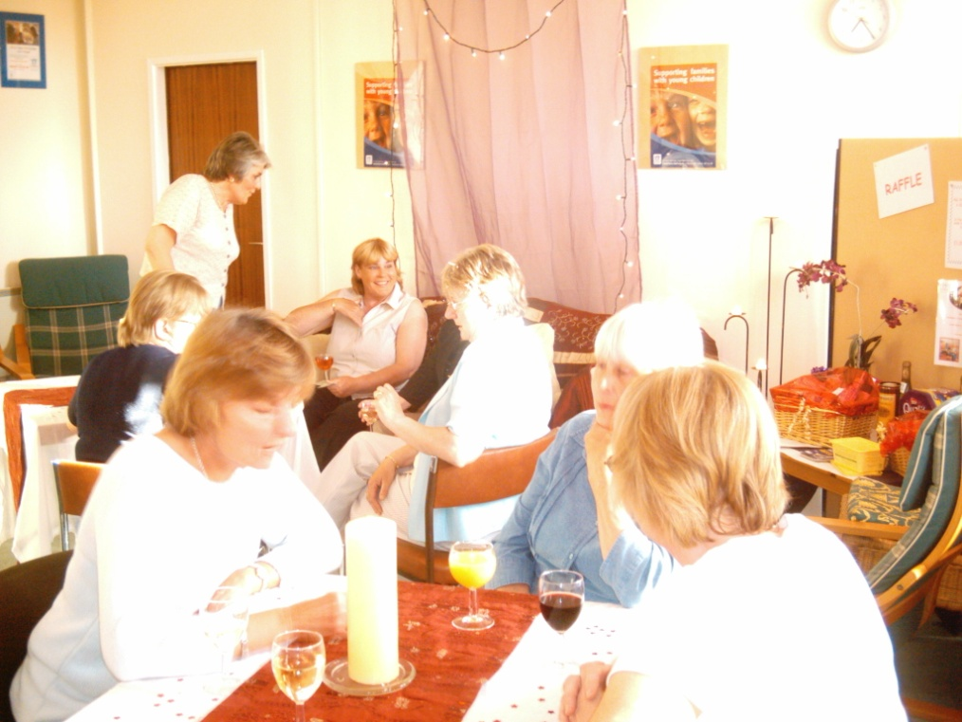
What do we do for volunteers?
Preparation Course
Ongoing training
Volunteer Support
Regular supervision
Paid expenses
Out of hours contact
numbers

Slide 14
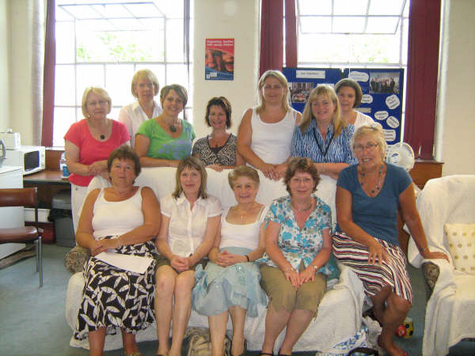
Preparation Course
9-10 week course
Informal
Topics covered include: Safeguarding, domestic abuse, mental health, communication, confidentiality
No role play
Scenario based

Slide 15
Management Committee
Their role is to govern the scheme and employ the staff team.
All volunteers.
Range of skills and experience
From all walks of life.
Meet bi-monthly.

Slide 16
Summary

Slide 17
Any questions ?

