Slide 1
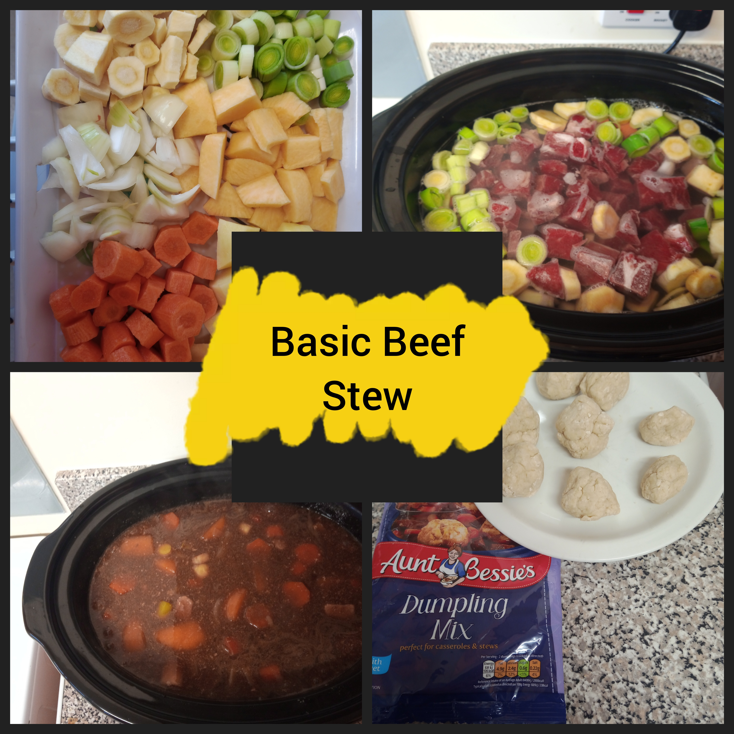
400g Diced Beef
(Fresh or Frozen)
2 Potatoes
2 small or 1large leek
1onion
3-4 carrots
1swede
2 Parsnips
Beef Gravy Granules
Dumpling Mix (optional)
1. Peel and Dice the potatoes and Swede.
2. Peel and Chop carrots, parsnips, onions and leeks.
3. Place all veg and Diced beef into the slow cooker and add boiling water to approximately 2inches from the top of the Crockpot.
4. Place the lid on slow cooker and cook on low for roughly 6-8hrs (normally will prepare around 10am and leave on low
whilst doing other things before serving at 5pm)
5. About an hour before serving stir in gravy granules to desired consistency (can use stock cubes but I use gravy
because it's less in price and I always have it at home),
6. Prepare and add dumplings (optional)
All Veg can be interchangeable and extra added or some removed if wanted.

