Slide 1
Self Harm - 23 January 2026
Training for Home Start Wyre Forest Volunteers
Dr Rose Papadopoullos
Clinical Psychologist
drrosepap@proton.me

Slide 2
    Self Harm
- What is self harm?
- Why do people self harm?
- How common are self harm and suicide?
- Identifying the signs that someone might be hurting themselves
- What can I do, as a Home Start Volunteer?
- What other help is available?

Slide 3
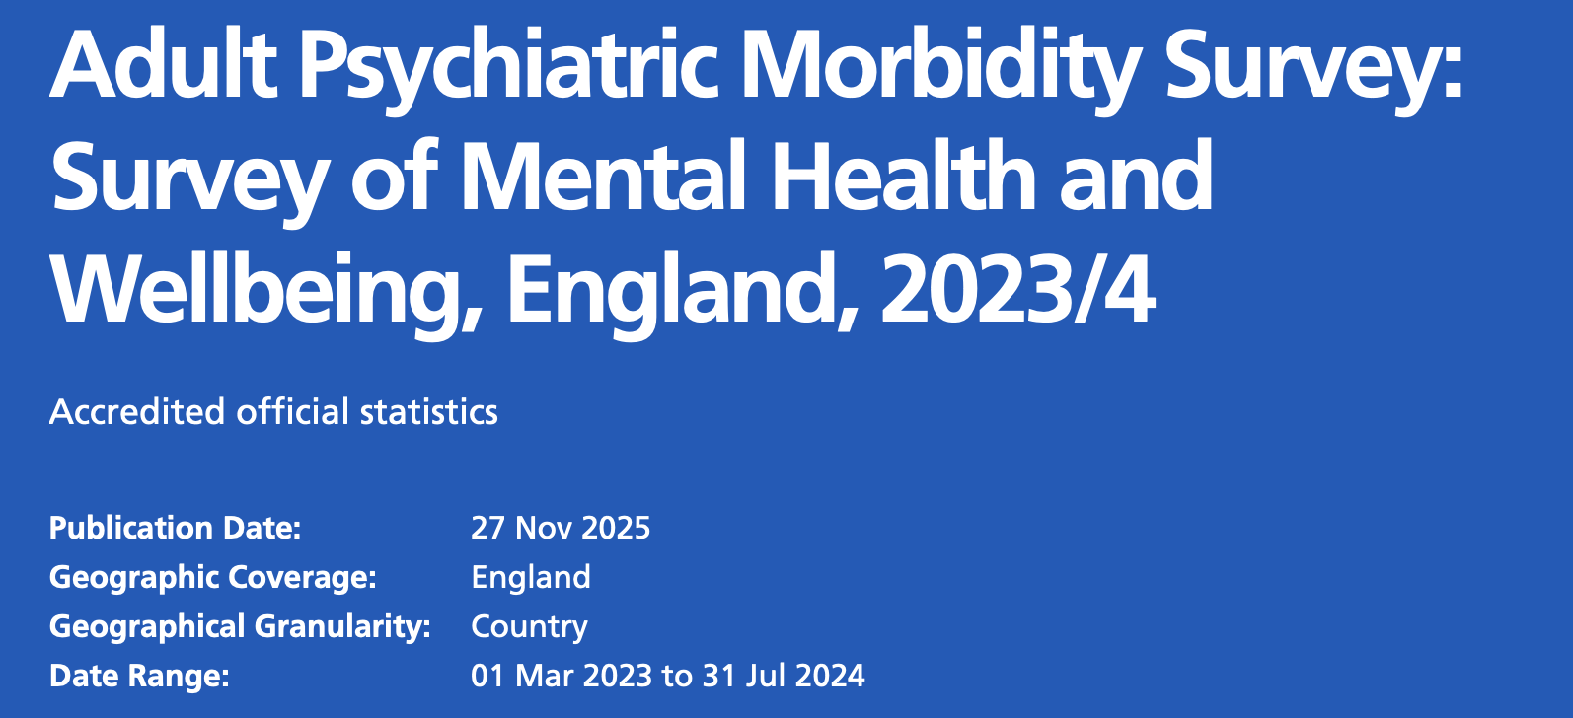
    What is Self Harm?
We can think about self harm as being any deliberate physical hurt to themselves while managing distressing feelings, or feeling overwhelmed, or seeking connection to someone.
self-injurious behaviour (SIB)
self-mutilation
non-suicidal self-injury (NSSI)
deliberate self-harm (DSH)
self-abuse
self-inflicted violence (Klonsky, 2011).

Slide 4
MYTH
OR
FACT?
“It’s mostly female teenagers who self harm”

Slide 5
“It’s mostly female teenagers who self harm”
It is true that girls are more than twice as likely to self harm as boys. However there are some other important vulnerable groups to know about, many of which are very relevant to the families we support:
Young people who are gay or gender fluid
People from mixed or Multiple Ethnic groups
Unemployed or not working, especially for men
Problem debt
Adults with a limiting physical health condition
Common mental health diagnosis (such as depression, anxiety, panic, phobia, OCD)
Self harm often begins in adolescence but a person can self harm at any age. Anyone who experiences overwhelming feelings, loss of control or sudden distress may use self harm to cope.

Slide 6
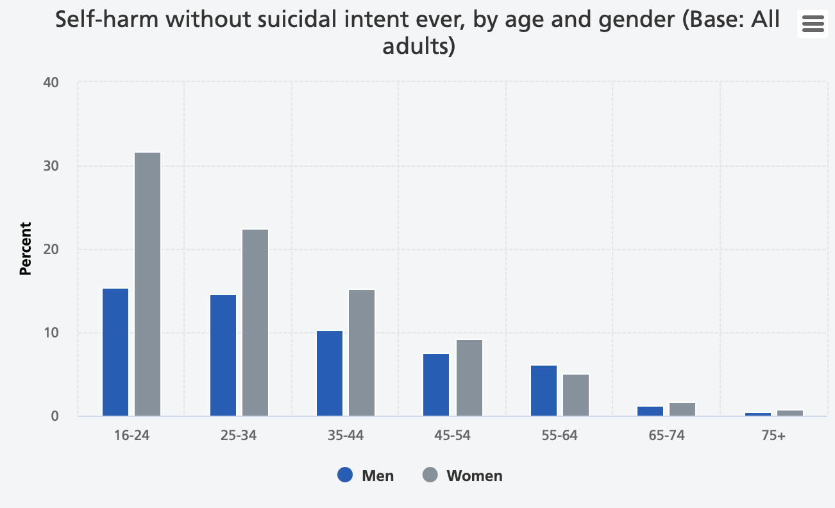

Slide 7
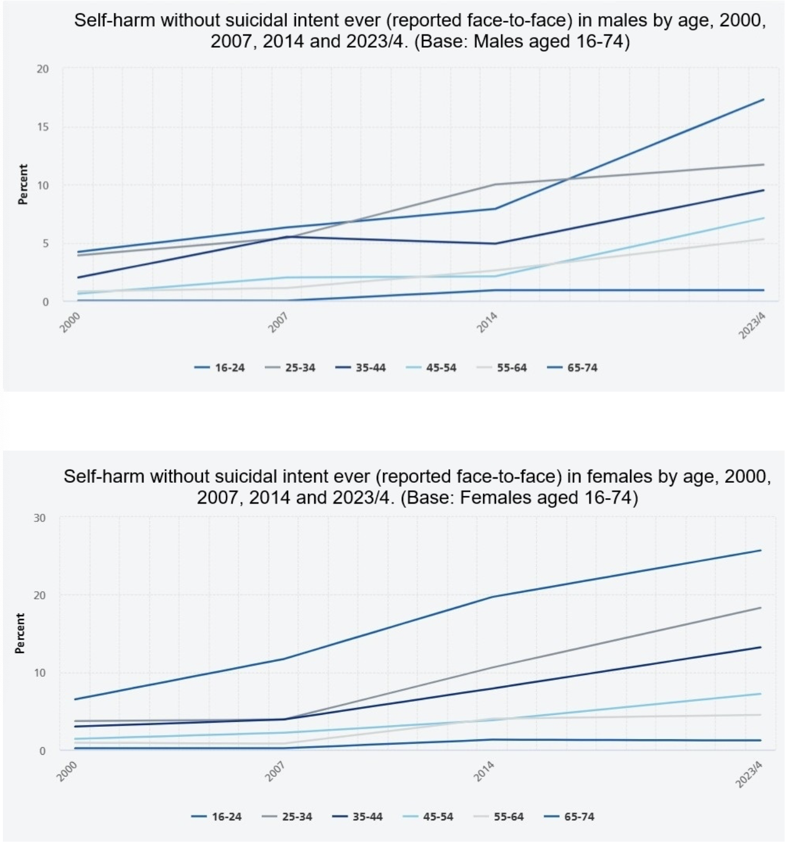

Slide 8
MYTH
OR
FACT?
“Self-harm is a suicide attempt”

Slide 9
“Self-harm is a suicide attempt”
Self-injury is a form of communication, and often a way of coping for someone trying to stay alive.
The majority of people who self harm do not have suicidal thoughts while injuring themselves.

Slide 10
    Self Harm vs. Suicide attempt
 | SELF-HARM | SUICIDE ATTEMPTS
FREQUENCY | Usually quite frequent | Attempts are usually infrequent
METHODS | Cutting, burning and self-hitting are most common | Poisoning is most common
SEVERITY | Usually less severe | Usually much more severe, and sometimes will be lethal
PURPOSE | Most often as relief from difficult thoughts and feelings - to avoid suicidal impulses | Done with an intent to die

Slide 11
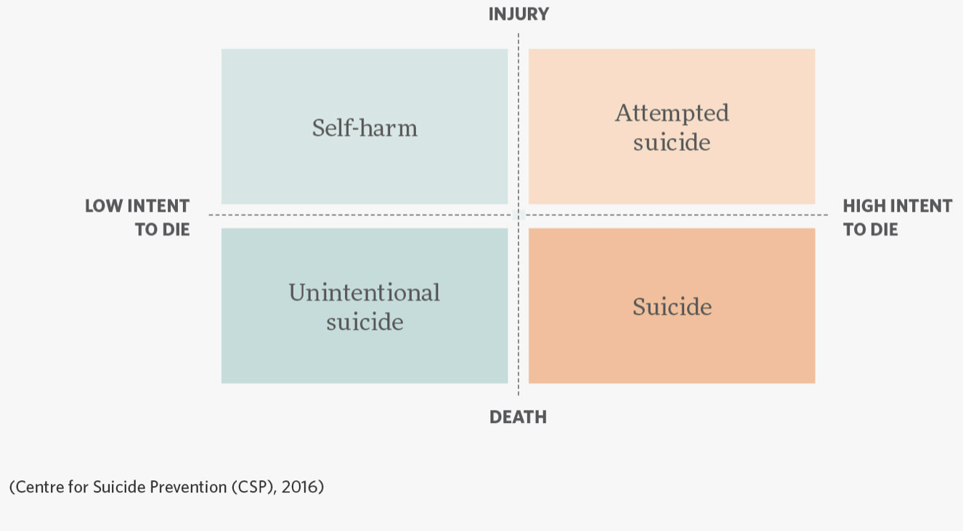

Slide 12
Self harm can escalate into suicidal thoughts and behaviours because:
Someones intent to die can change
Self harm might stop feeling like an ‘effective’ coping method, e.g. it no longer provides a feeling of relief.
In a crisis, people who already self harm might feel less frightened to hurt themselves for the purpose of suicide

Slide 13
MYTH
OR
FACT?
“Self-harm is attention seeking behaviour”

Slide 14
“Self-harm is attention seeking behaviour”
Self harm is not about attention seeking. It may be about attachment or connection seeking. There are many reasons why people self harm;
Allowing someone to express feelings of rage, or gain control where they have none
An act of punishment to themselves, feeling they deserve it
A way of communicating a need or want to receive care
A coping mechanism to feel alive when a person has dissociated
A way of stopping themselves from hurting others
A way of managing overwhelming feelings

Slide 15
“Relief from difficult thoughts/feelings”
The most common reason given for self-harming

Slide 16
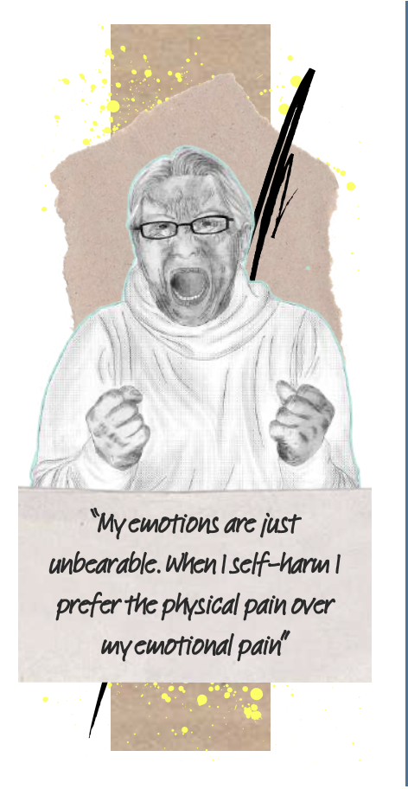
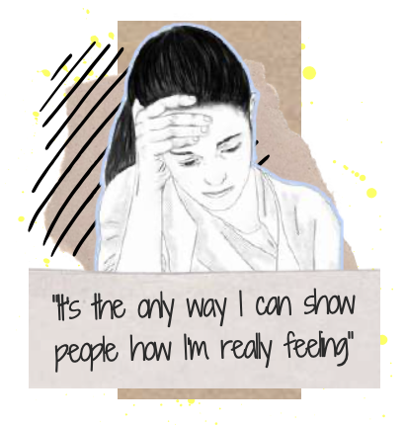
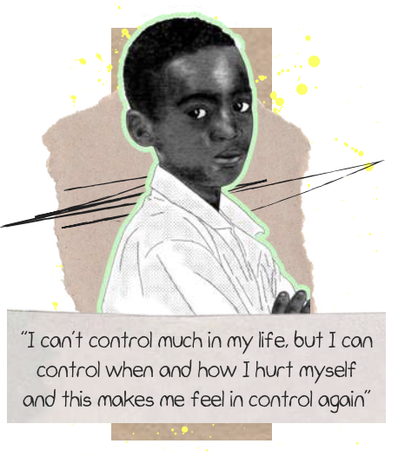
    Credit: Beacon House

Slide 17
MYTH
OR
FACT?
“Cutting is the only form of self harm”

Slide 18
“Cutting is the only form of self harm”
We can think about self harm as being any deliberate physical hurt to themselves while managing distressing feelings, or feeling overwhelmed, or seeking connection to someone.
There can be ‘direct’ forms of self harm, and ‘indirect’ forms of self harm.

Slide 19

    Direct and Indirect Self Harm
Direct
Indirect
Suicide attempts
Self injury without suicidal intention such as:
  Picking skin, opening old wounds
  Breaking bones, punching kicking
  Hair pulling
  Head banging
  Overdose with medication
Substance or alcohol misuse
Restricting or binge eating
Over-exercising
Sexual risk taking
Starting fights
Tattoos or body piercings (research suggests around 1.8% of adolescents who get tattoos are doing so “for the purpose of feeling pain”)

Slide 20
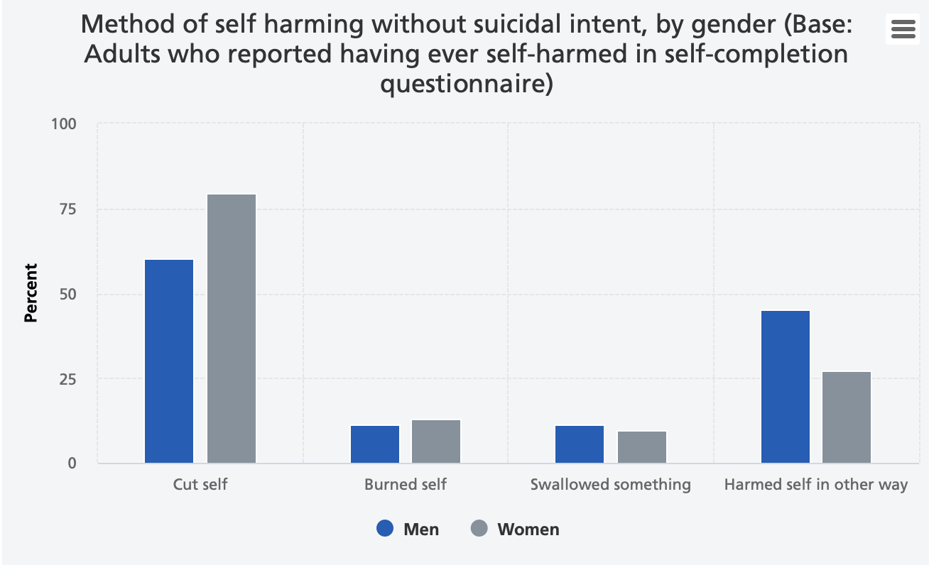

Slide 21
    Digital Self Harm
Relatively new with very little research
“The the anonymous online posting, sending, or otherwise sharing of hurtful content about oneself”
Described as increasing over time amongst teenagers

Slide 22
MYTH
OR
FACT?
“Social Media can cause young people to self harm”

Slide 23
    Social Media and Self Harm
A paper in 2025 found that 50% of adolescents using social media
had been exposed to self-harm content during a 1 week period.
Those who had seen self-harm content online were more likely to self harm that week than those who had not been exposed to this content.
They found no direct increase in suicidal thoughts or actions.
(Hamilton et al. 2025)

Slide 24
    Social Media and Self Harm
Large research study pulled together 15 other papers 2023:
The majority of papers found that looking at images of self-harm online had harmful effects. This included:
an increase in self-harm
triggering urges to self-harm
enabling social connections with others who are self-harming, which can reinforce an individual’s personal identity as someone who self-harms.
However, nine of the studies also indicated some ‘protective’ effects for some young people, including:
reduction in urges to self-harm for some
social connection with other people which led to providing and receiving support
(Hawton et al. 2023)

Slide 25
    Self Harm Iceberg
What are the signs someone might be hurting themselves?
Appear withdrawn or more quiet than usual
Avoid regular activities, people or places
Rapid changes in mood
Become angry or upset easily
Significant recent events which are distressing or traumatic
Struggling academically
Struggling with peers
Unexplained cuts, scratches or other marks
Wearing clothes that seem inappropriate to the weather e.g. long sleeves pulled down on a hot day

Slide 26
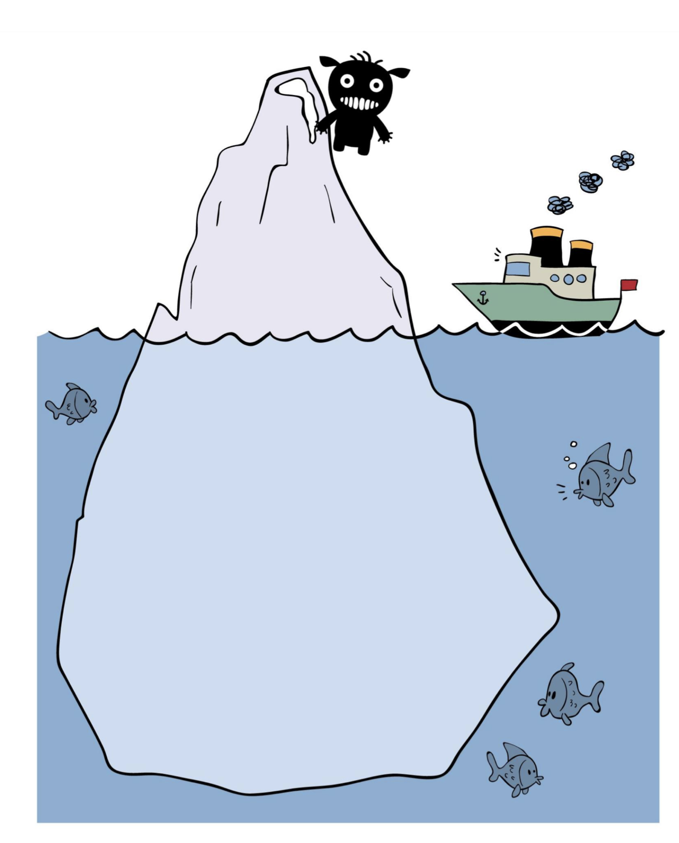
    Self Harm Iceberg
What are the signs someone might be hurting themselves?
How might that person be feeling underneath this?

Slide 27

    Self Harm
What can I do as a Home Start Volunteer?
You don’t need to avoid the subject, especially if someone brings it up to you
Encourage people to speak to their GP, or to reach out to another service (see last slide)
Listen non-judgmentally, and empathise with their struggles
Do not promise to keep secrets for young people. If they don’t want you to tell their parents/carers, be curious about why, and if you aren’t sure what to do speak to the volunteer co-ordinator at HomeStart
In an emergency - contact 999 or visit the nearest A&E

Slide 28
    Self Harm
Do you want to talk about it? To me, or someone else?
What to say to someone who is self harming
Things must be really hard right now
How are you feeling?
I am here for you
I’m so glad you have told me about this
I can see you are in pain

Slide 29




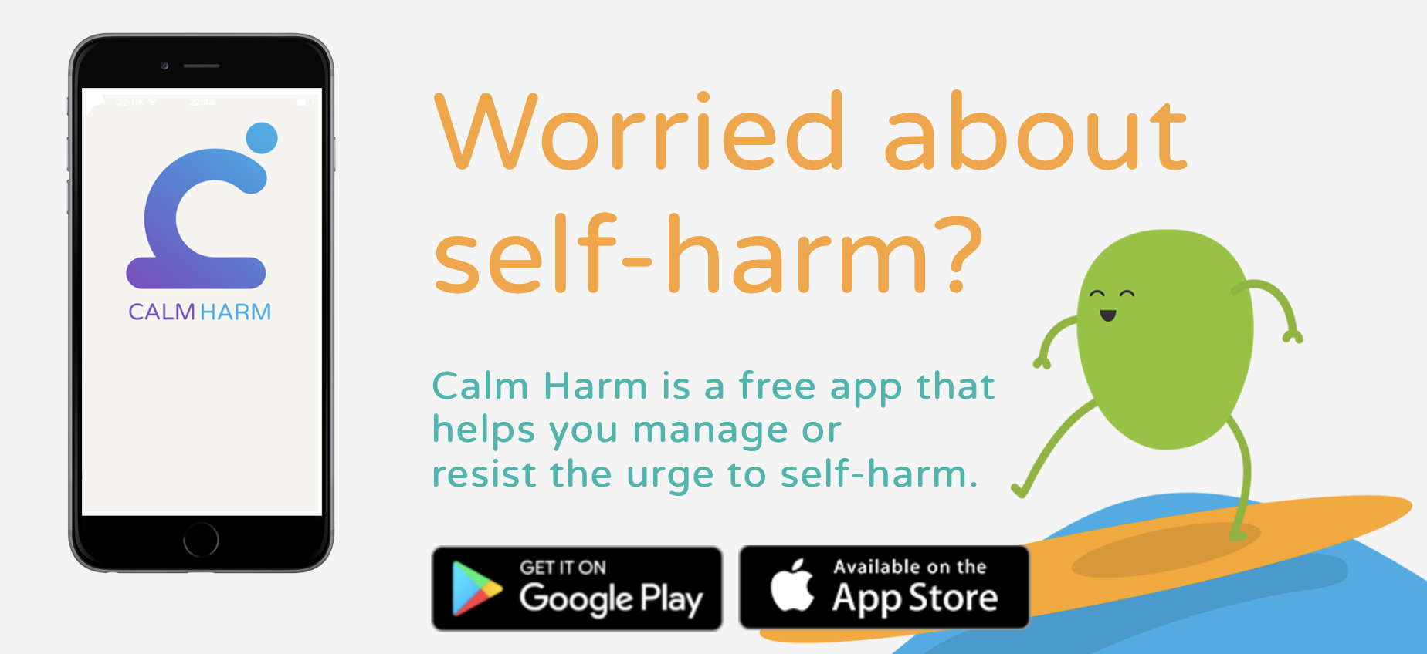

    Self Harm
What other help is available?

Slide 30
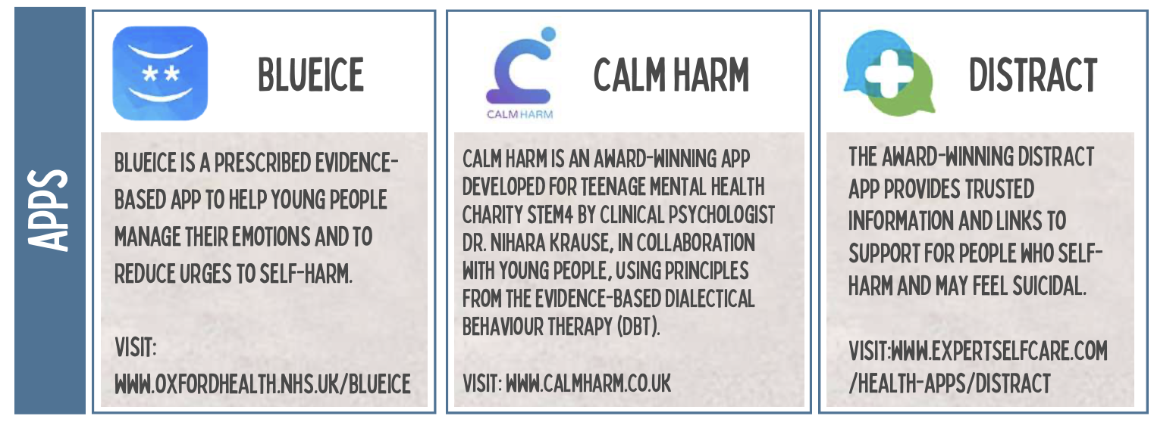
    Credit: Beacon House

